Slide 1




SMART INDIA HACKATHON 2026
TITLE PAGE
  Problem Statement ID –SIH26039
  Problem Statement Title-Al-Powered Underground Mine Safety, Monitoring and Rescue System.
  Theme-Smart Automation
  PS Category-Hardware
  Team ID-
  Team Name (Registered on portal)

Slide 2
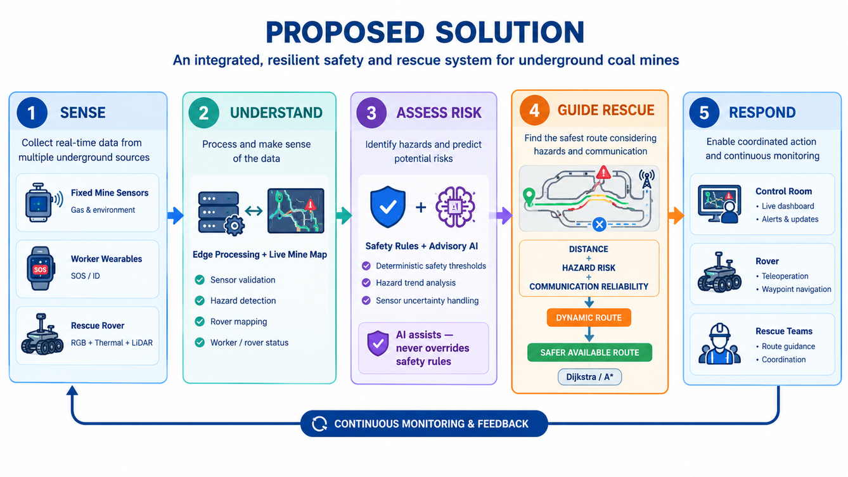
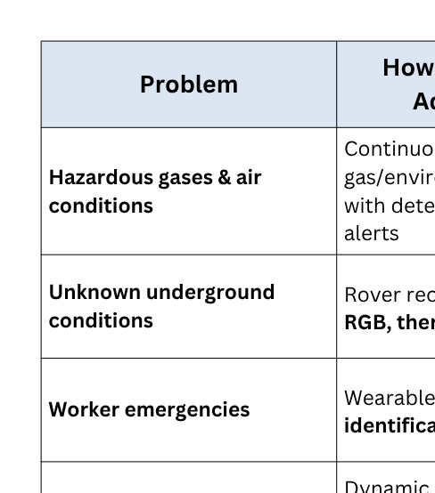
An integrated, resilient safety & rescue system for mines
Your Team Name
WHAT MAKES OUR APPROACH DIFFERENT?
COMMUNICATION-AWARE RESCUE ROUTING
We don't choose a route based on distance alone.
The system considers hazard risk + distance + communication reliability to guide rescue through the safest available connected path.
AI THAT CANNOT OVERRIDE SAFETY
AI assists decisions — it does not control safety.
AI detects trends and provides recommendations, while deterministic safety rules remain the final constraint.
GRACEFUL DEGRADATION
Safety doesn't depend on every component working perfectly.
Sensor, communication, rover, backend or AI failures trigger fallback mechanisms instead of assuming conditions are safe.
@SIH Idea submission- Template
2

Slide 3
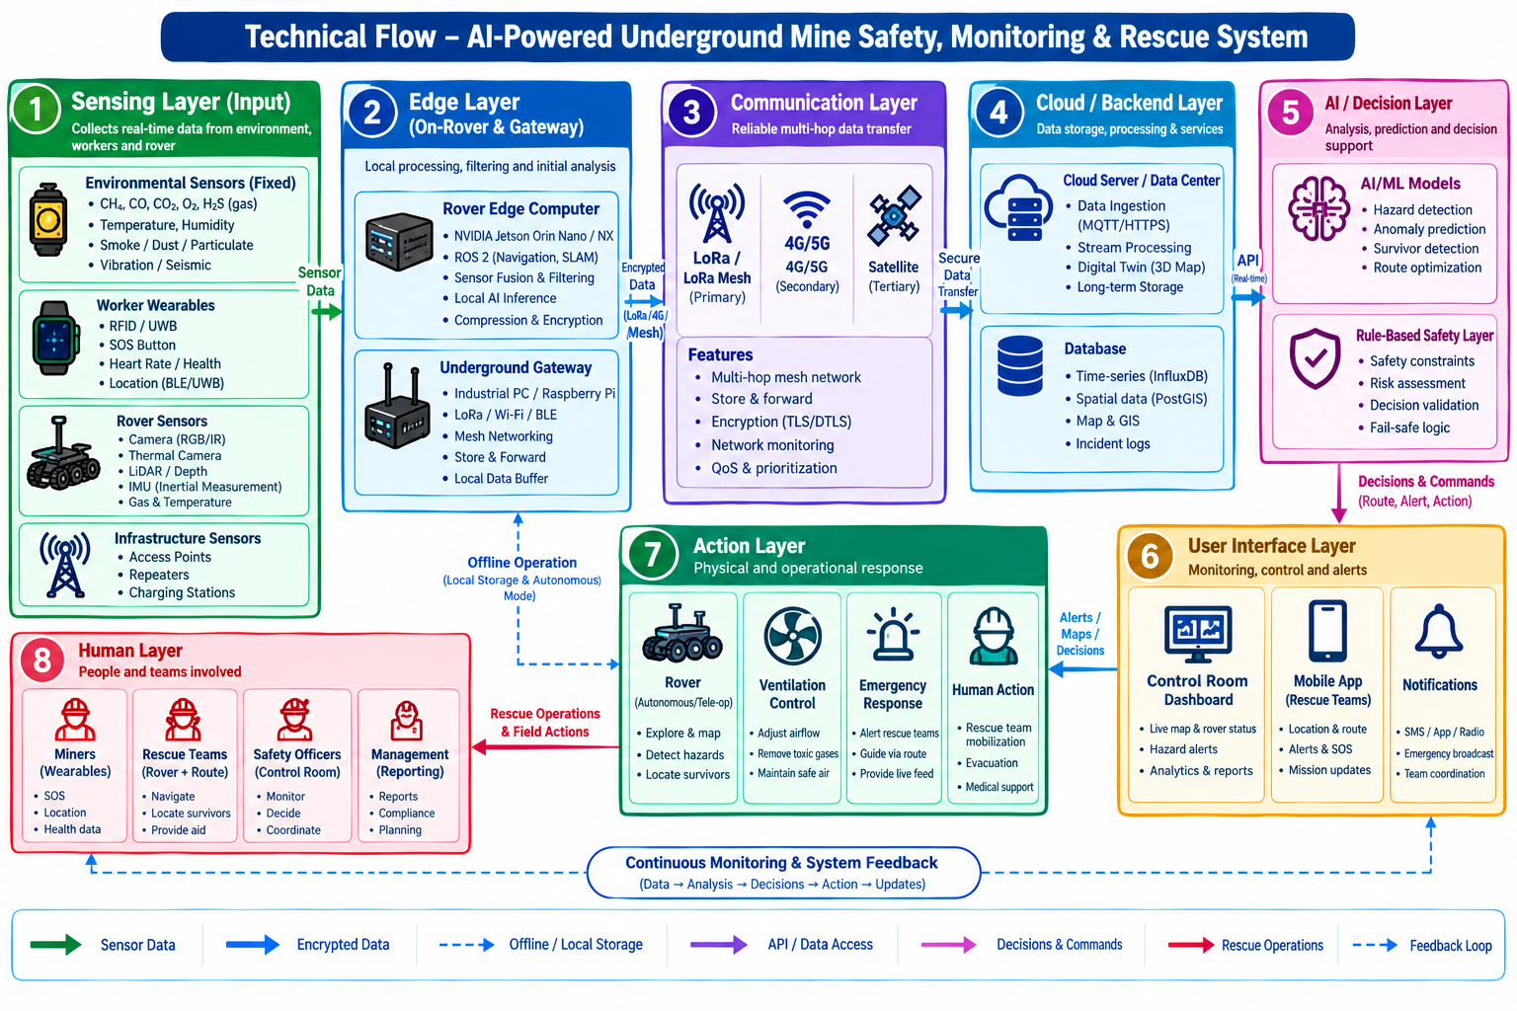
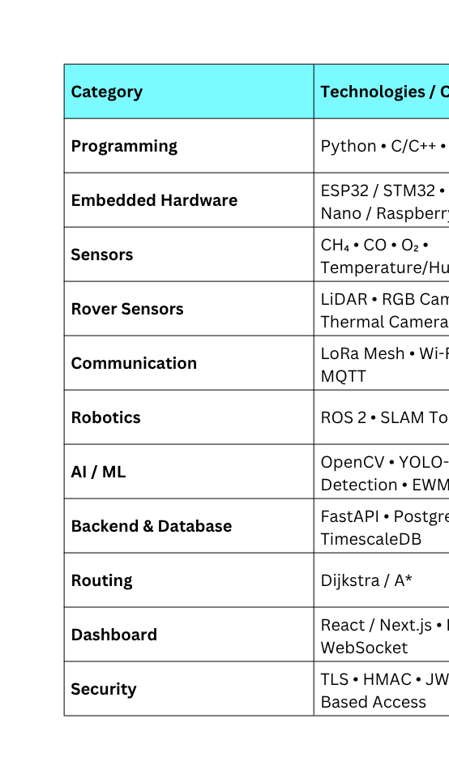
TECHNICAL APPROACH
Your Team Name
@SIH Idea submission- Template
3

Slide 4
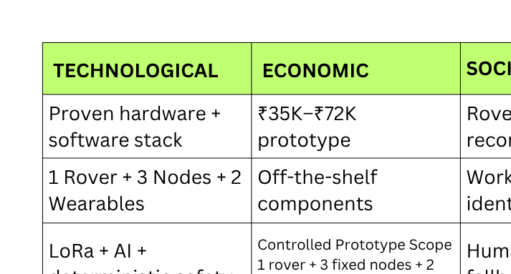
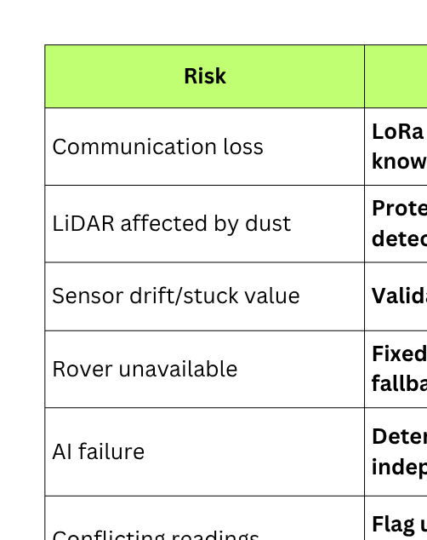
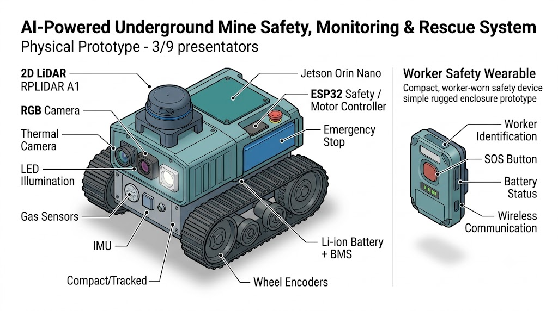
FEASIBILITY AND VIABILITY
Your Team Name
Practical prototype | Controlled scope | Risk-aware design
@SIH Idea submission- Template
4

Slide 5
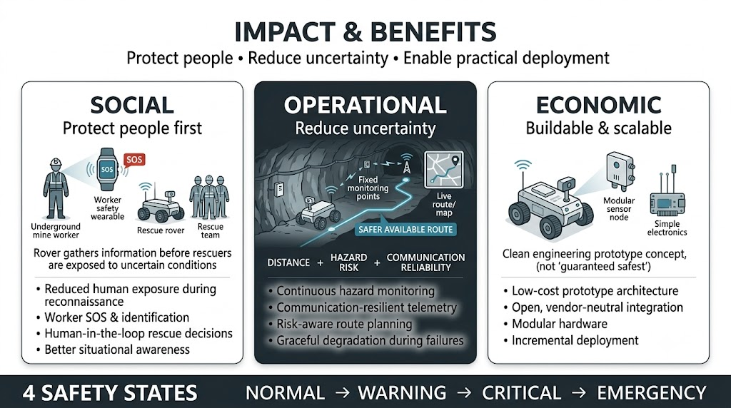
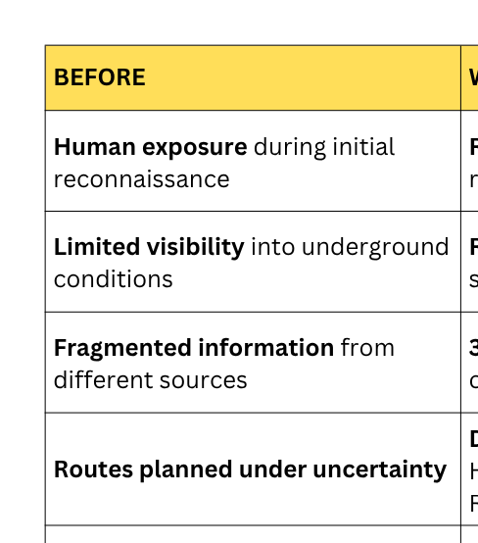
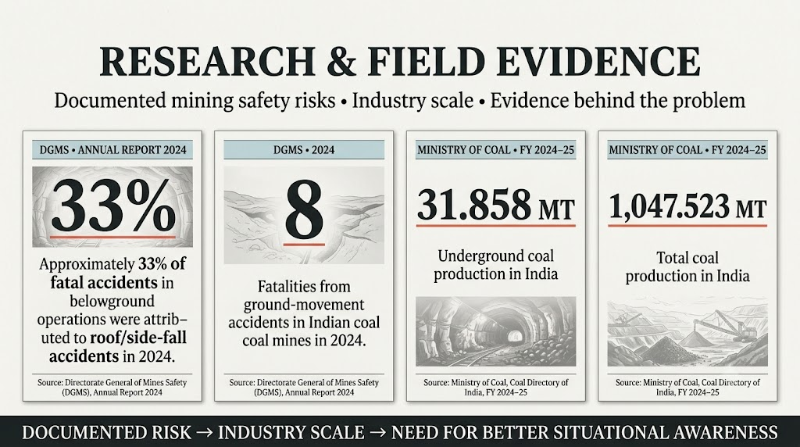
IMPACT AND BENEFITS
Your Team Name
FROM UNCERTAINTY → INFORMED RESPONSE
@SIH Idea submission- Template
5

Slide 6
RESEARCH AND REFERENCES
Your Team Name
  Details / Links of the reference and research work
@SIH Idea submission- Template
6

Slide 7
IMPORTANT INSTRUCTIONS
Please ensure below pointers are met while submitting the Idea PPT:
  Kindly keep the maximum slides limit up to six (6). ( Including the title slide)
  Try to avoid paragraphs and post your idea in points /diagrams / Infographics /pictures
  Keep your explanation precise and easy to understand
  Idea should be unique and novel.
  You can only use provided template for making the PPT without changing the idea details pointers (mentioned in previous slides).
  You need to save the file in PDF and upload the same on portal. No PPT, Word Doc or any other format will be supported.
  Note - You can delete this slide (Important Pointers) when you upload the details of your idea on SIH portal.
@SIH Idea submission- Template
7

